Slide 1
Data Visualization
Duration: 40 mins
Session by : Krithika, Aman, Aryan, Rajeev Panchal

Slide 2
At the end of this session:
Data Visualization
Learn what data visualization is
Know its history and significance
Understand types of charts and use cases
Learn about Shaffer’s 4 Cs
Get a few handy tips
Know some popular tools
Familiarize with developer libraries
Notes:
UX Design Institute – Sample Usability Test Script-3-2-7.pdf

Slide 3
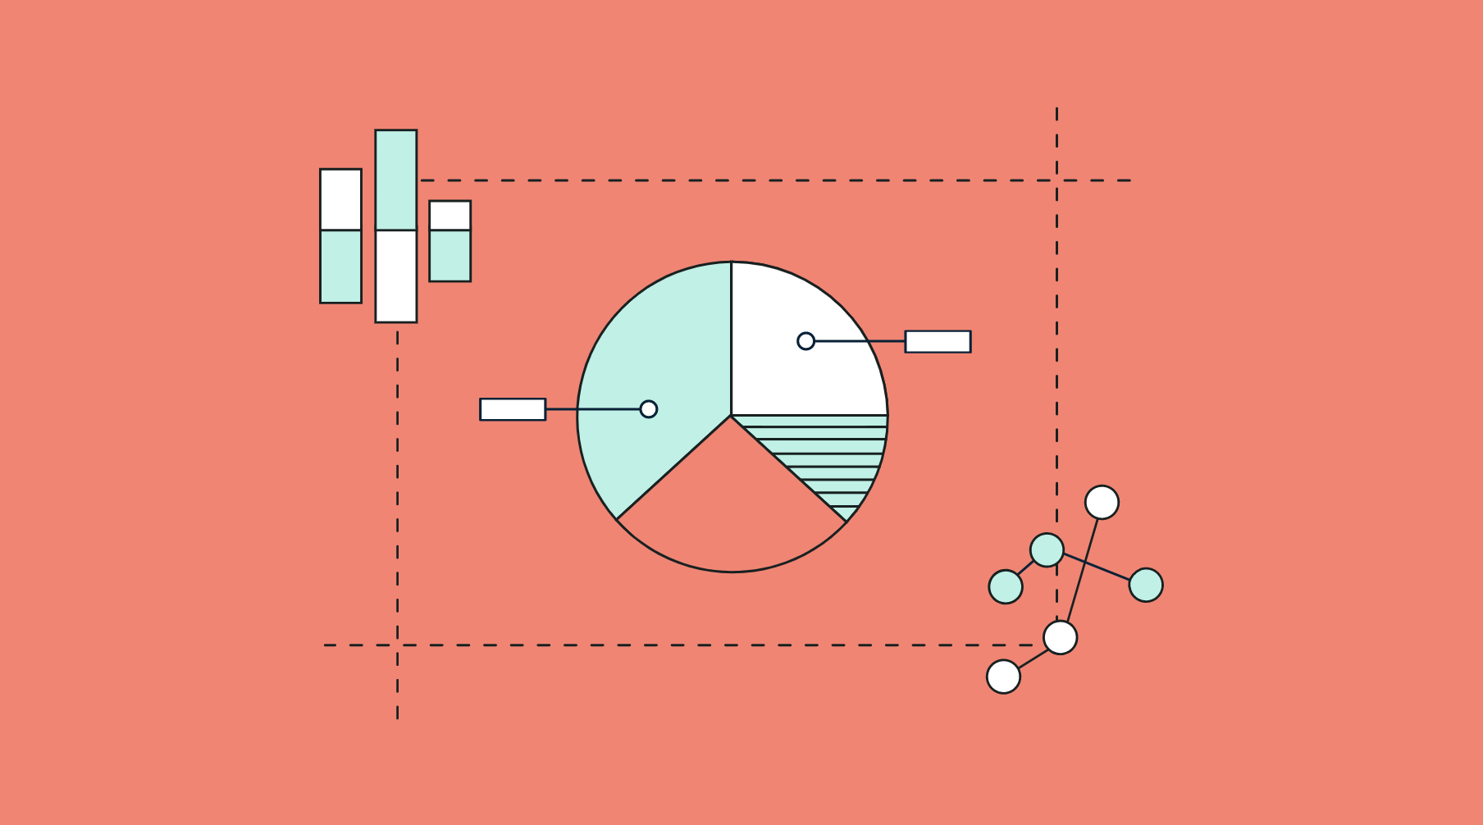

What is data visualization?
Data Visualization
Data visualization is the graphical representation of information and data. By using visual elements like charts, graphs and maps, data visualization tools provide an accessible way to see and understand trends, outliers and patterns in data.
Notes:
What is Data Visualization?
It is nothing but the graphical representation of information and data using different visual elements like charts and graphs.
Today, We live in the world of Big Data. There’s data all around us, all the time and it can get overwhelming some times right?
Good data visualization practices and techniques are essential to help users consume and understand the data easily.
You can think of it as storytelling, but with a purpose.

Slide 4
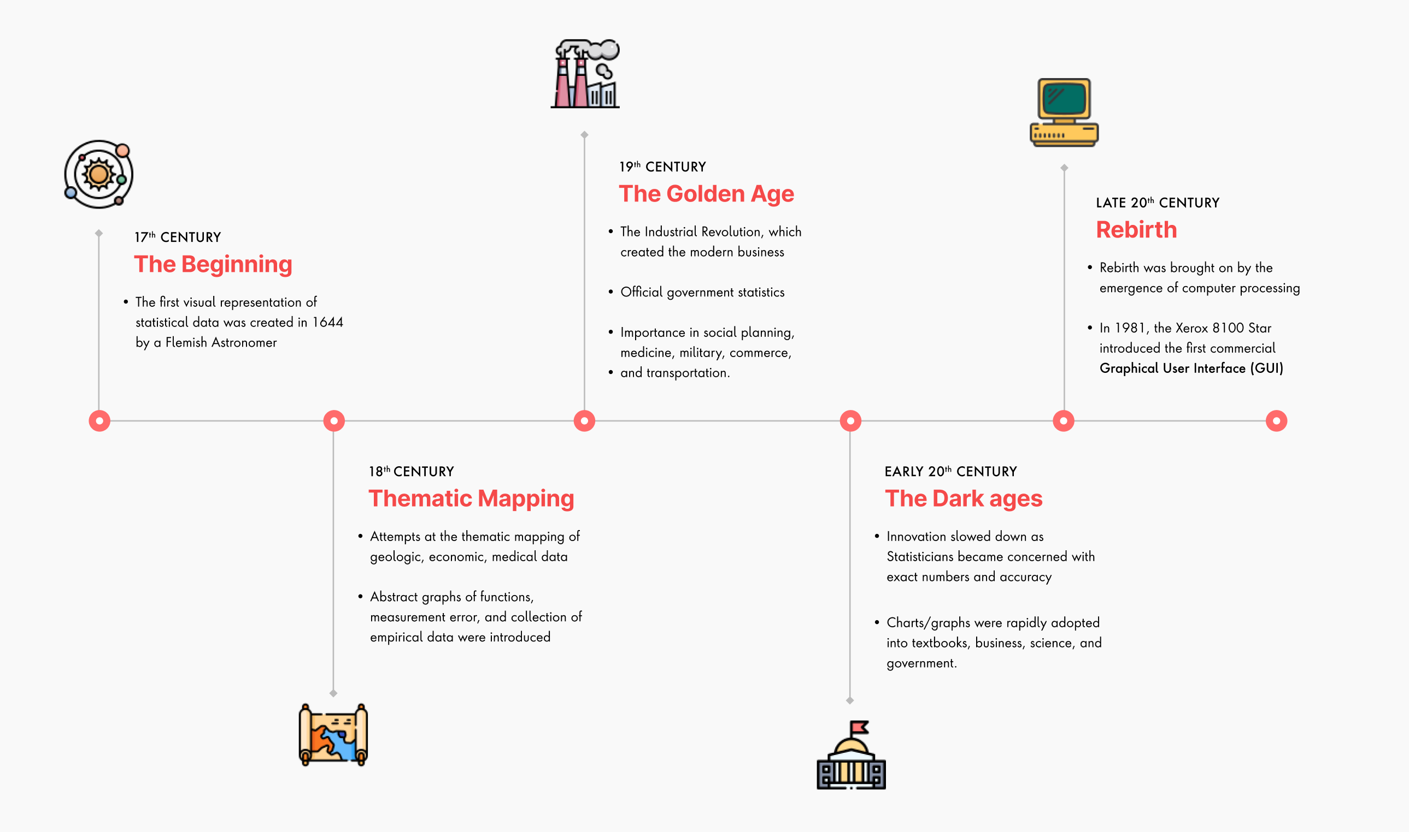
History of data visualization
Data Visualization
Notes:
Though we think of this as modern innovation, data visualization has been around for centuries.
Some of the earliest forms of DV were actually maps which have been around in some form or another for at least ten thousand years.
Let’s take a quick look at how it has evolved over time.
In the 17th century, Michael Florent Van Langren, a Flemish astronomer, provided the first visual representation of statistical data.
The 18th century was more focused on economic and medical data.
This period also gave us one of the pioneers in this field, his name is William Playfair, he is the inventor of many of the most popular graphs we use today (line, bar, circle, and pie charts).
More than two hundred years later, the ideas of one man still make up the bulk of the chart options in state of the art data visualization software.
The 19th century was considered the golden age thanks to the Industrial revolution and increase in availability of official govt statistics.
Innovation slowed down in the early 20th century but picked up again rapidly towards the end due to the emergence of computers.
Many statistical chart types, including histograms, time series plots, contour plots, scatterplots, and others were invented during this period.

Slide 5
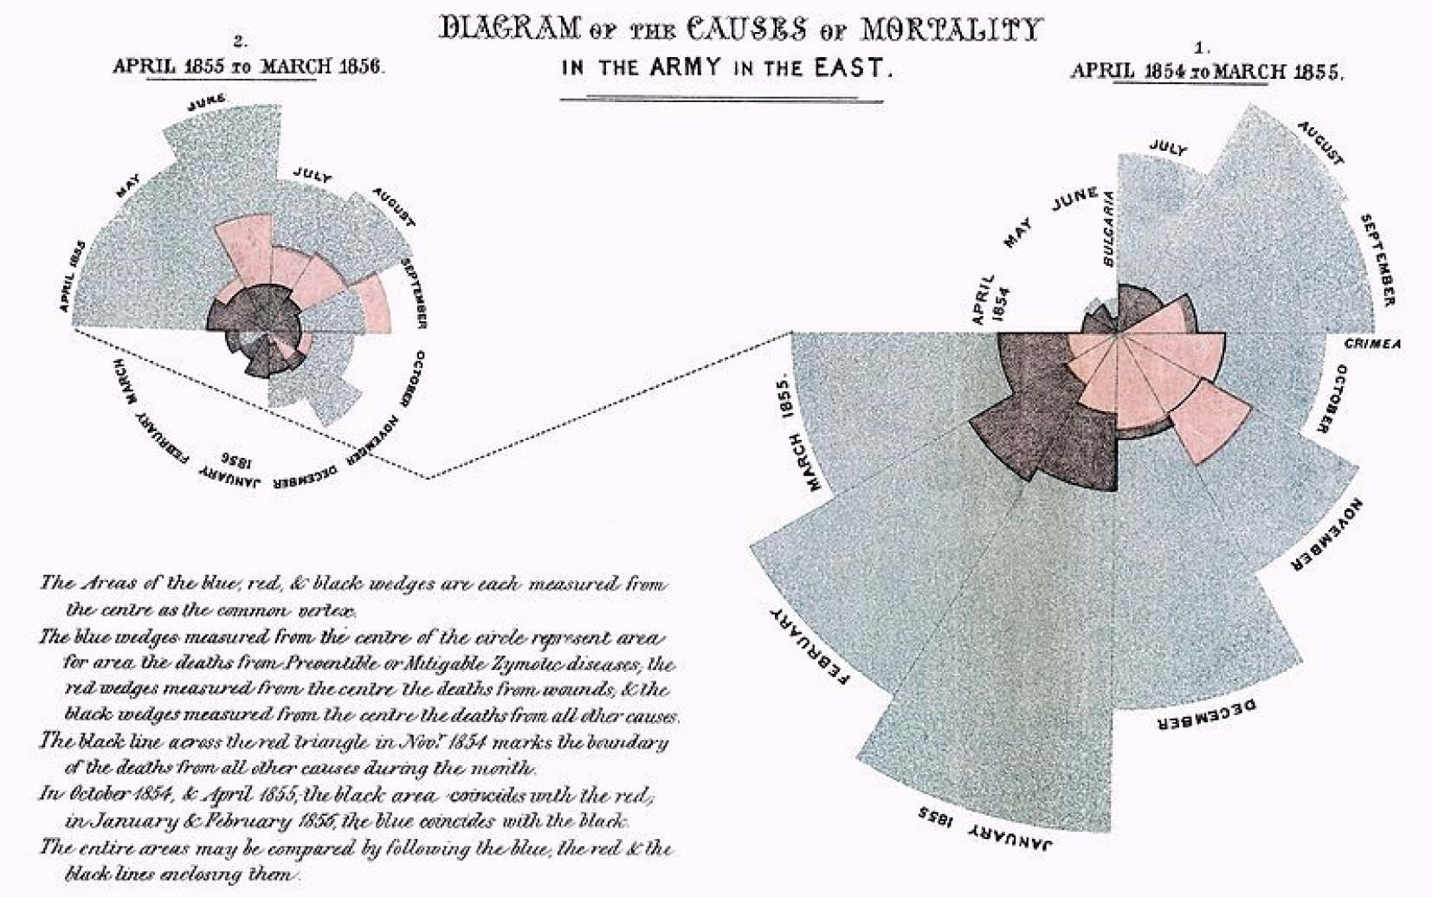
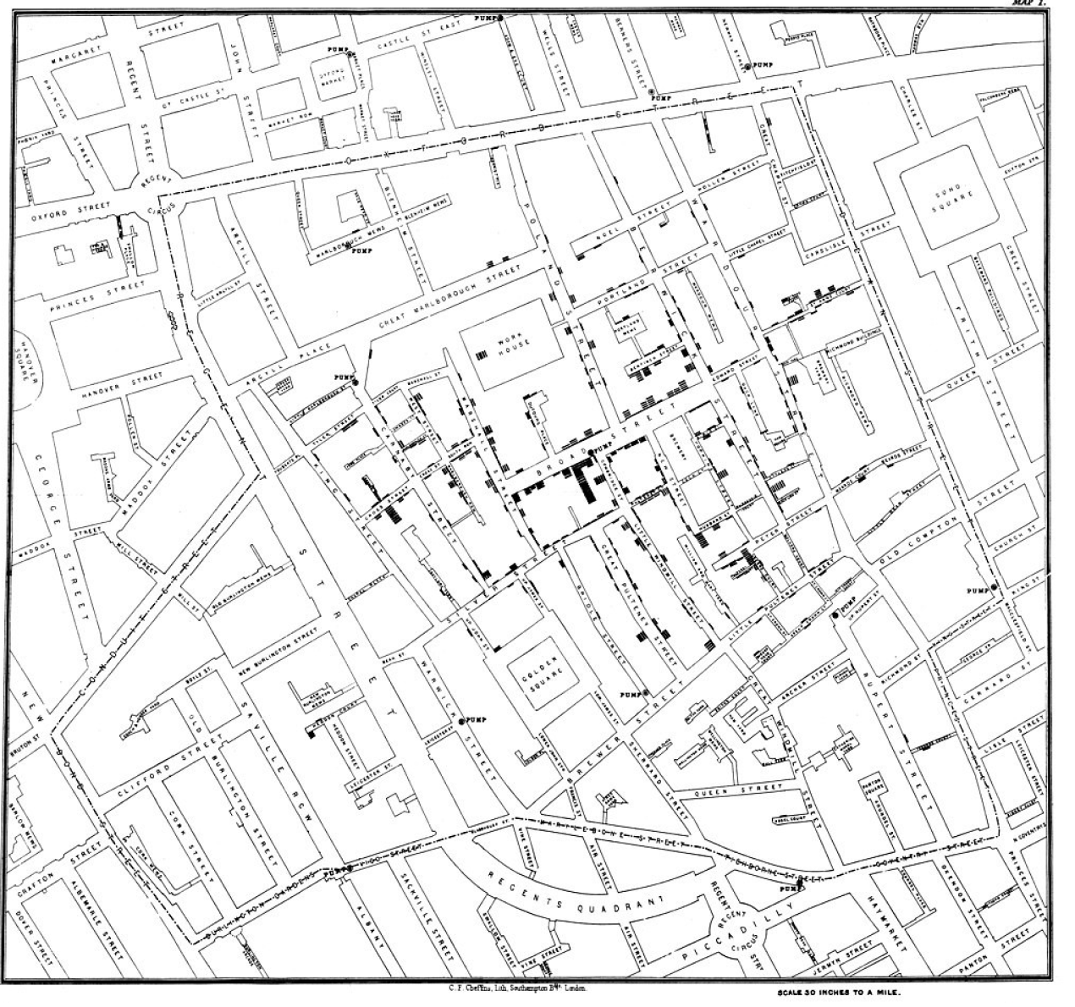
Creating impact through data visualization
Data Visualization
Rose chart created by Florence Nightingale. She made several studies of the sanitary conditions in Crimea, India and the UK, and used charts like the above in lobbying for reform.
John Snow mapped the Broad Street Cholera Outbreak of 1854 using a dot map, showing that the disease spread via contaminated water, rather than air.
Notes:
Around the 19th century people started to understand the impact that a really good data visualization can have.
They started to use it to bring about government reforms and try to create a change in society.
I’m sure we might have all heard of Florence Nightingale? She was one of the founders of modern nursing but she was also a mathematician and a pioneer in the data visualization field.
She studied the poor hygiene conditions in countries like India and the UK, and used charts like the above in lobbying for reform, basically trying to convince the government to allocate more money in their budget towards Health. They say that because of her work, the average life expectancy in the UK increased by 20 years. So you can see the impact it has had on people’s health and lives
Now take a look at the map on the right. This was used to depict the Cholera outbreak in London, initially they thought it was spreading through air but once they actually did the visualization they realized that it was through the water supply and so they could immediately take measures to correct this.

Slide 6
DATA VISUALISATION
Principles &
Types of Charts

Slide 7




Data Visualization
Design charts using Shaffer’s 4 Cs
Data visualizations can be shown in a more meaningful way using Shaffer's 4 Cs.
Clear
Clean
Concise
Captivating
Easily seen
Sharply defined
Thorough
Complete
Unadulterated
Simple but
comprehensive
Excellent
Attention grabbing
Interesting
Accessible
Notes:
I will show you a series of steps that allows you to move from excel default graphs into professional and powerful graphs. Shaffer 4 C’s. Shaffer’s 4 C’s refers to clean, clear, concise and captivating.
Clear means easily seen and sharply defined. Some factors to take into account when defining your graphs, who is the audience and what's the message? Clarity is more important than aesthetics.
Clean, apply, thorough, complete, unadulterated. To achieve this, revise your labels, axes, gridlines, formatting, write, chart type, color choice, etc.
Concise refers to being brief but comprehensive. In other words, minimalist but not verbose.
And lastly, make sure your visual is captivating. To ensure this, ask yourself the following questions does it capture your attention? Is it interesting? And does it tell the story?
In the upcoming slides we will show you how you can apply these guidelines while creating the data visualization for the users.
Example: Look at the following data set. There's not much to tell, right? We have two columns of data categories on one side and numbers on the other. Not much information, I would say. So let's start first by inserting a bar chart. This is what Excel gives you by default. Not too clear, I would say. How about you remove or lighten the grid lines and lower the number of tick marks on the y axis. So instead of five increments, make it ten. Also, let's light on the color of both and y axis and make them Gray. Would it be cleaner if we remove the text from the x axis as well? Remove the series name and the title. Avoid rotated text. Rotate the chart instead. Order the bars. If there's a reasonable number of bars, consider data labels instead of axis labels. In our case, we'll keep the axis. Let's finish with some. Don'ts avoid narrow bars. Avoid connected bars unless you have a distribution, of course. Avoid stark borders on bars. Avoid the 3D bars. Avoid repeated text instead of repeating categories ten times, choose to add an access title. And finally, add the title. Tell the story. Include labels, dollars, number or percentages, data source, date, author, etc. So, by now, how do you feel? An expert in making visualization? See you in the next video.

Slide 8
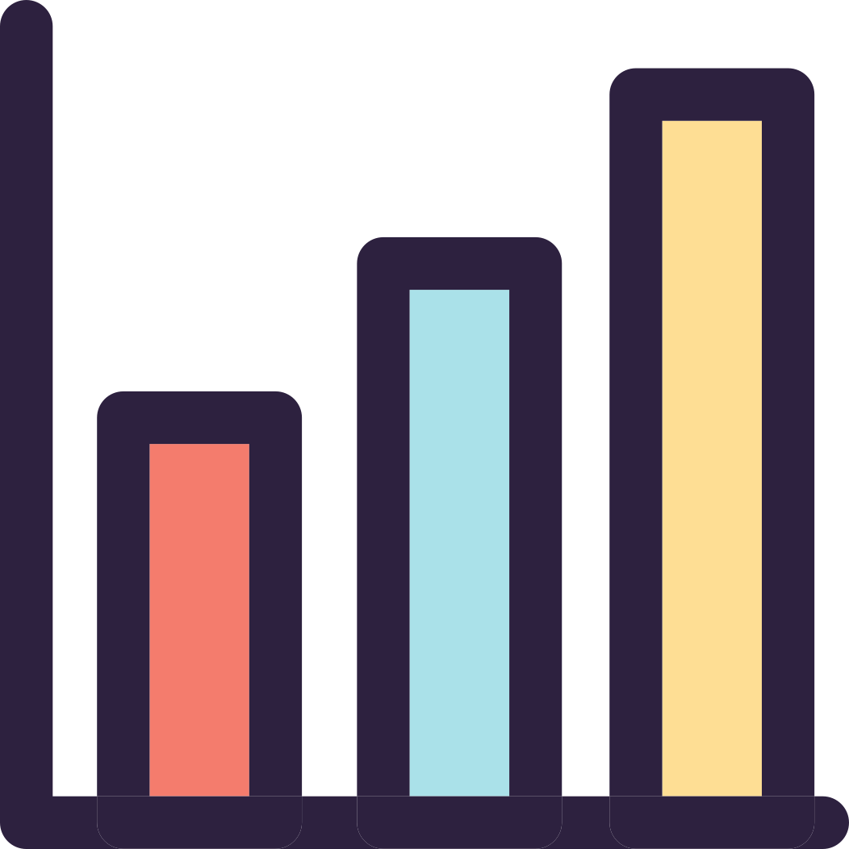
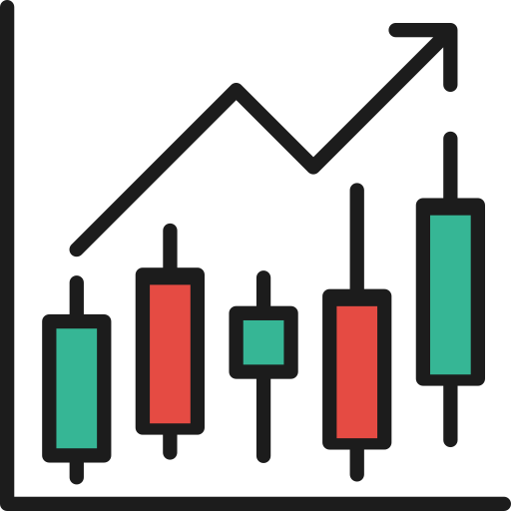
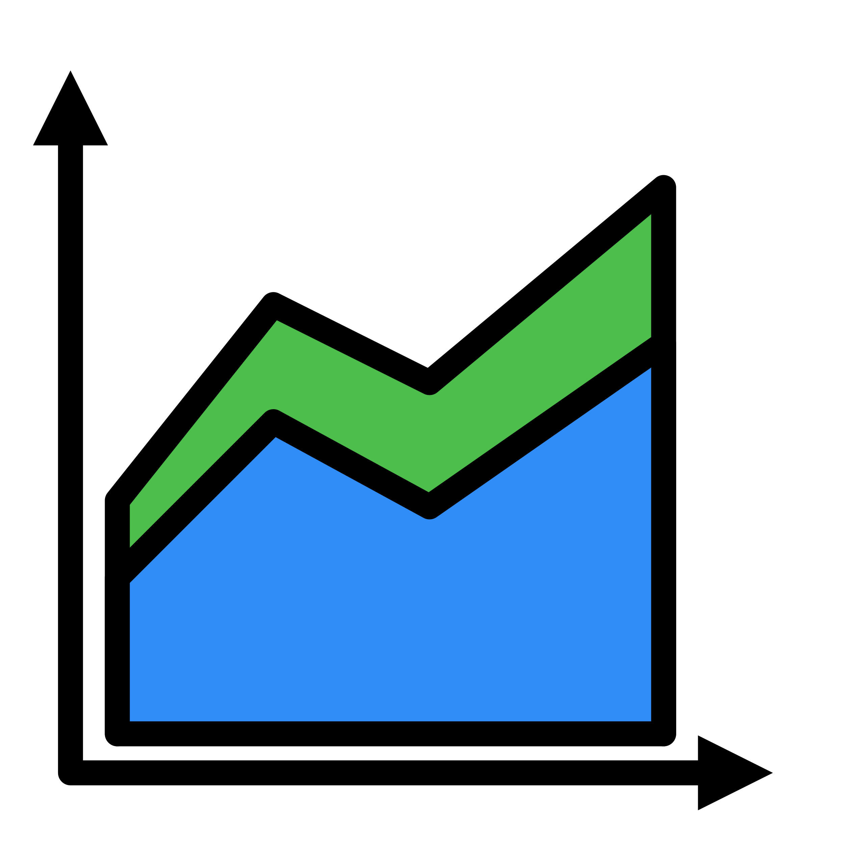
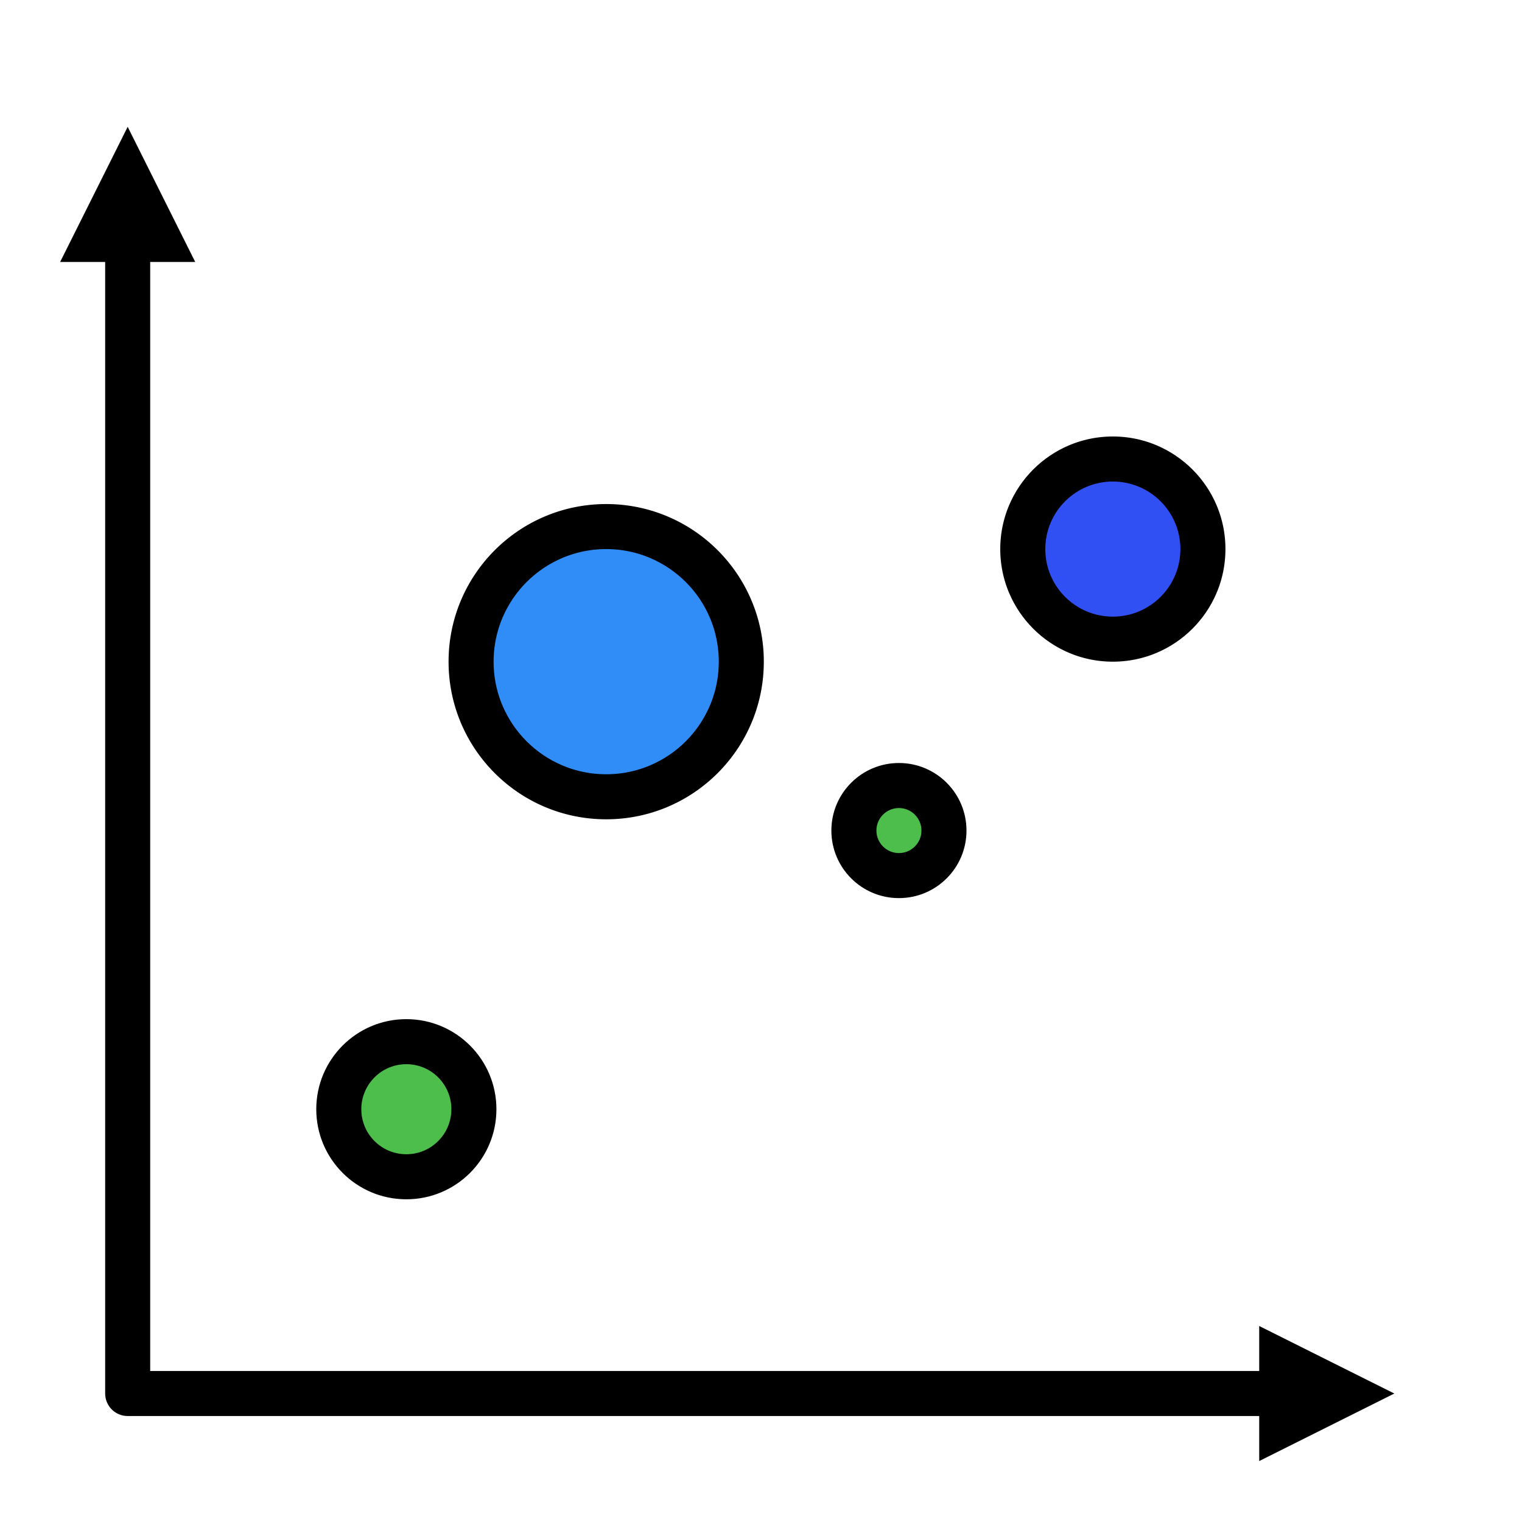


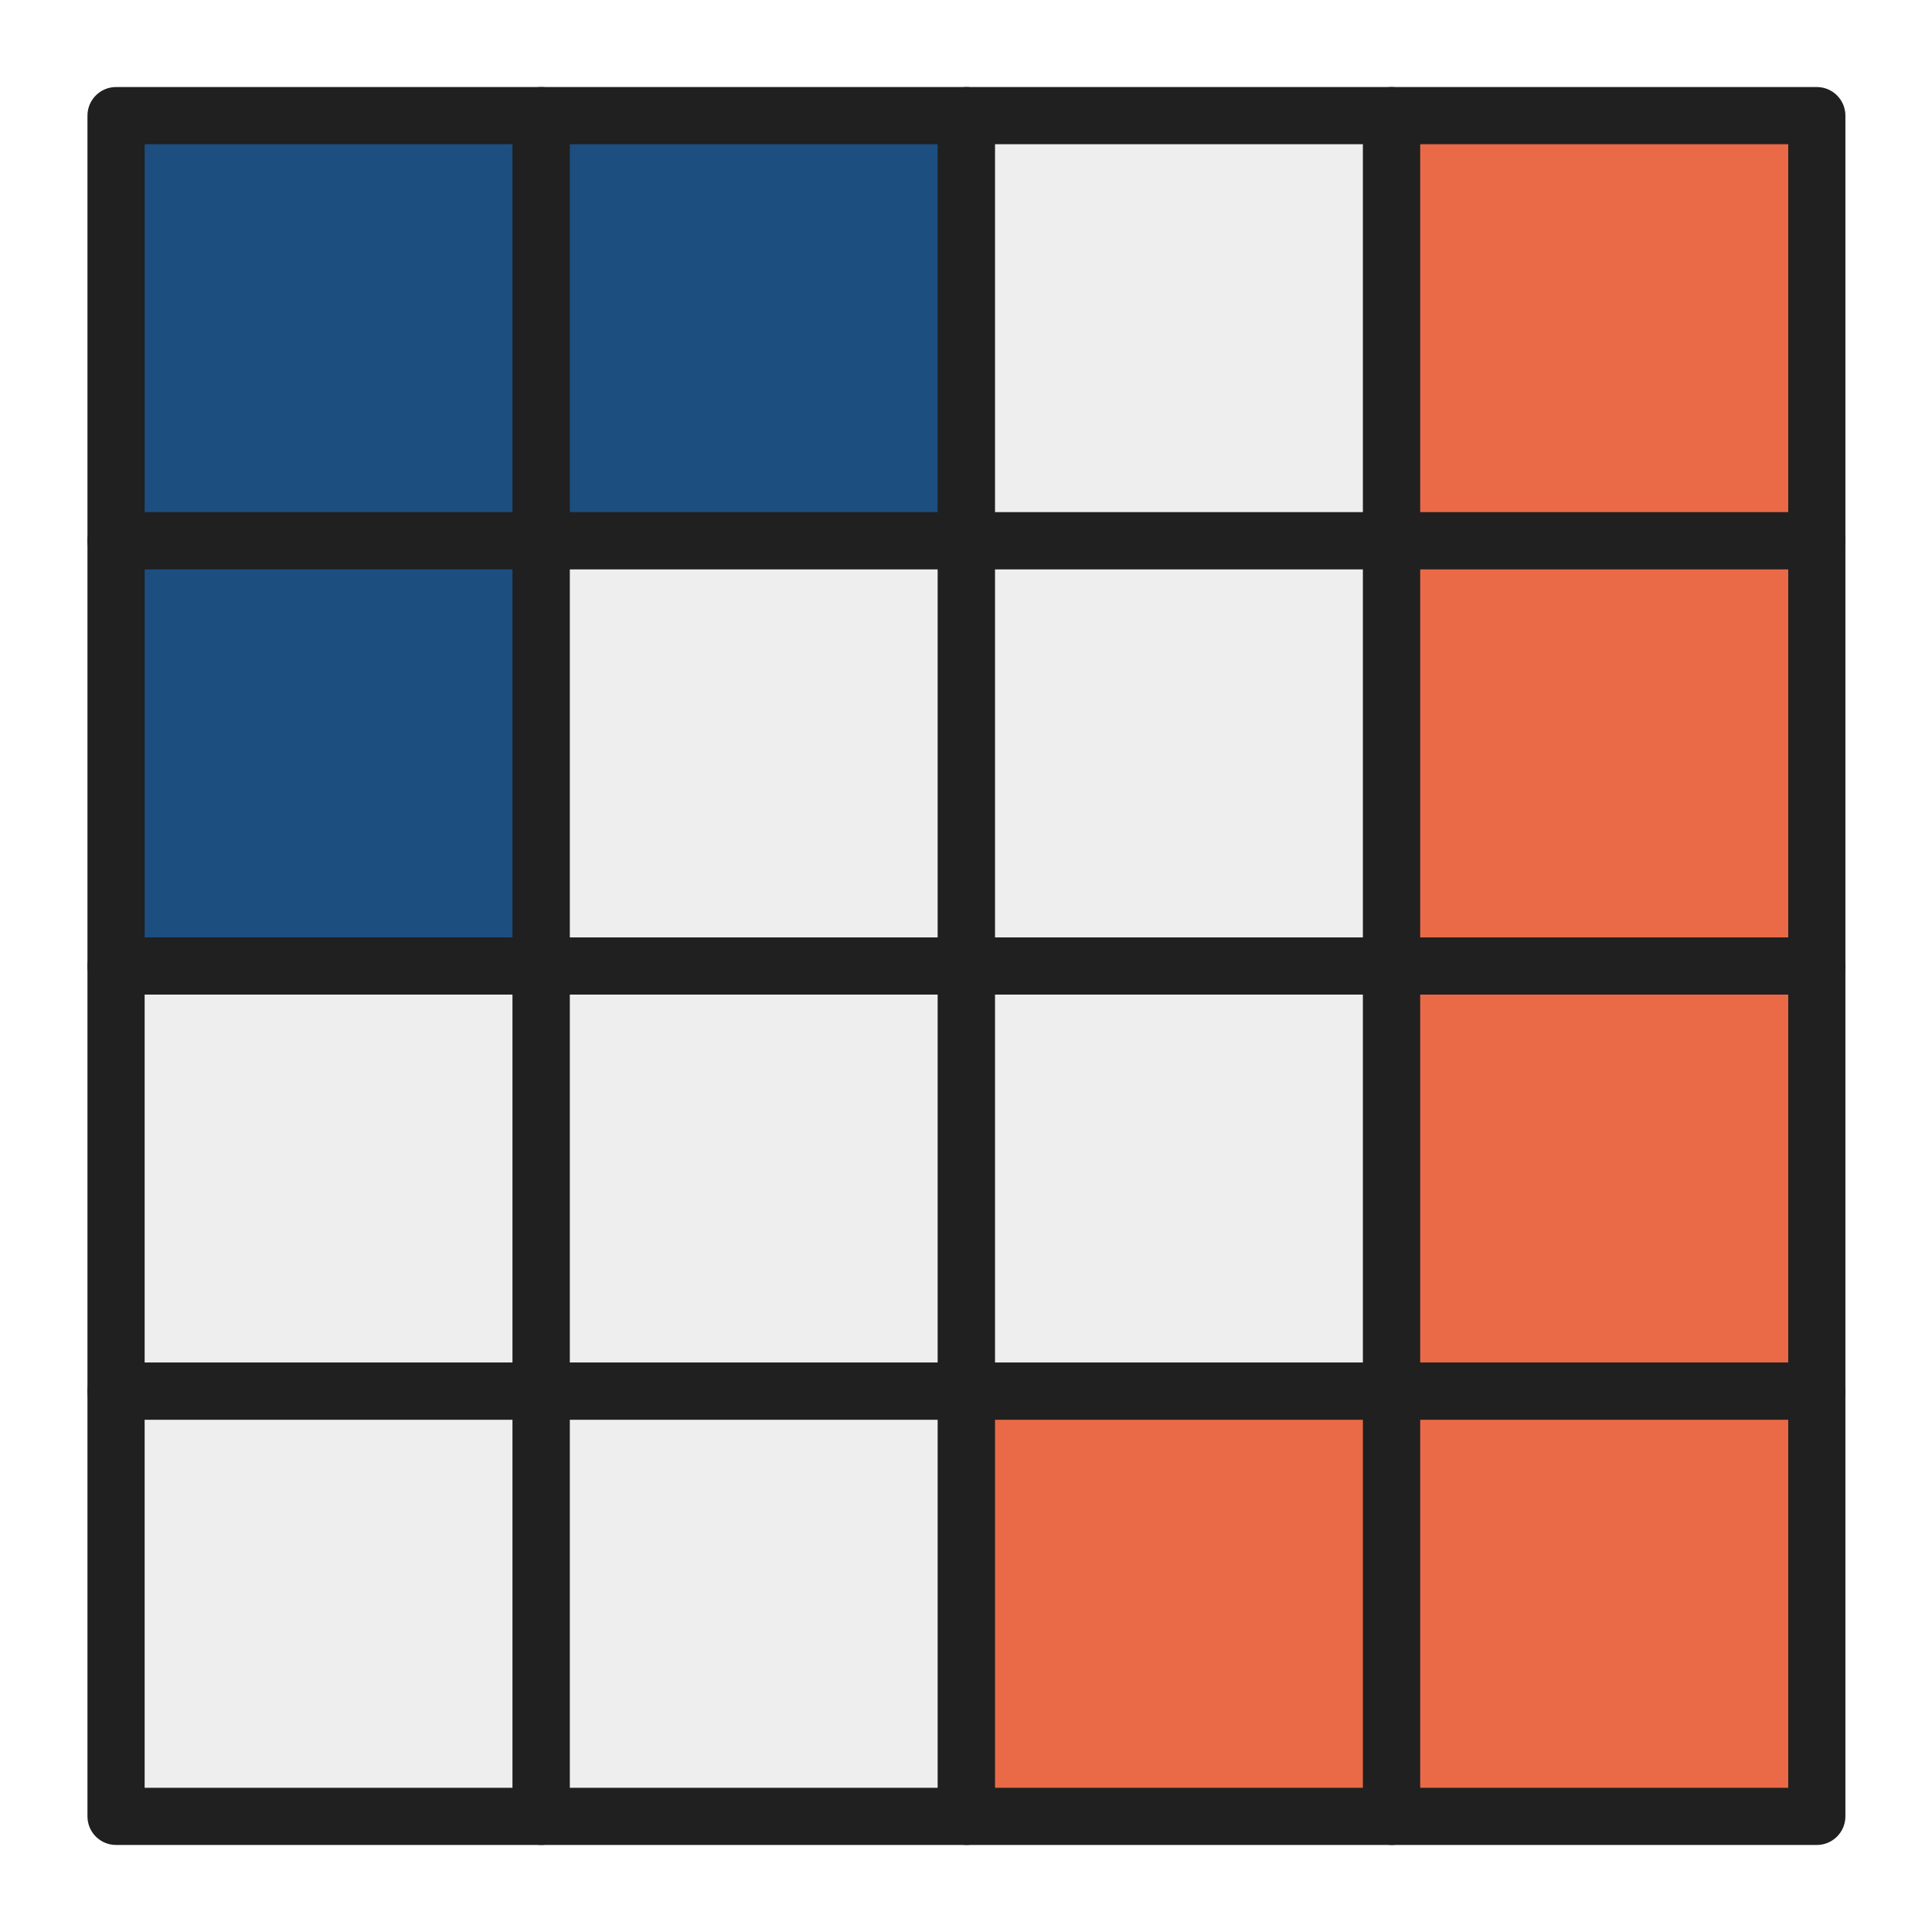
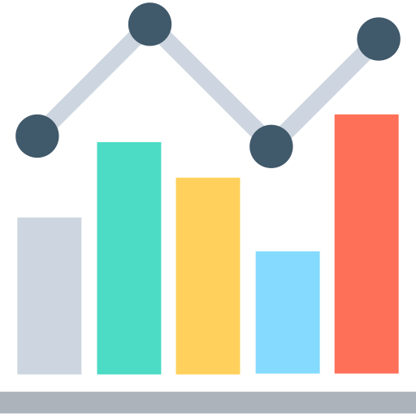
Types of charts
Data Visualization
There are more than 40+ graphs/charts used to represent data. Let’s look at the most common ones.
What’s ahead…
Ways to visualize data
Types of charts, and variations
Notes:
Introduction Now that you know all about data visualization, lets move on to our next section where you will learn, how to visualize data using different types of charts. Charts are one of the most common way to perform data visualization. Today, there are more than 40+ charts that are used, but we will discuss only the most common ones. Just to give you a heads up, in the upcoming slides you will learn about 1. ways to visualize data 2. types of charts, and their variations

Slide 9
Visualize data
Data Visualization
There are majorly 3 ways to perform data visualization
Two axis
No axis
Color intensity based
As the name suggests, such charts have two axes, x-axis and y-axis. Examples are bar graphs, line charts, etc.
Such charts do not have any axis and show data in parts-to-whole way, like pie charts, heatmaps.
Colors are used to highlight focus points. Examples are heatmaps, bubble charts, etc.
Notes:
Before moving to our section of types of charts, I would like to tell you the 3 ways in which data is visualized when it comes to charts.
The first way is a 2-axis chart. As the name suggests, such graphs have a 2-axis and are generally used to compare data, with one axis defining timeline or magnitude, and the other one having data that is compared with the timeline The second way is a no axis chart, which have no axis like the pie charts which use a part-to-whole relationship concept to compare data
And the third way to represent data in charts are color intensity-based charts that use colors to highlight the focus points for example, heatmaps

Slide 10
TYPES OF CHARTS
2 Axis Charts

Slide 11
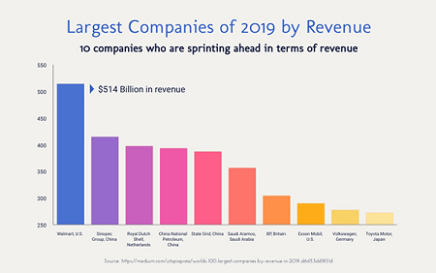
Bar charts
Data Visualization
Types of Charts / Two Axis
A bar chart presents categorical data using rectangular bars, with heights or lengths proportional to the values they represent.
Advantages
Summarizes the large set of data in simple visual form
Clarifies the trend of data better than tables
Helps in estimating the key values at a glance
Easy to develop and make interactive
Notes:
The first chart in our list is a Bar chart. You must have seen this chart every now and then in your daily lives. This chart uses bars that represents and is the most basic and common way to compare data. Along with providing a good idea of trends, a bar chart is also useful to estimate key values at a glance.

Slide 12
Bar chart variations
Data Visualization
Types of Charts / Two Axis
Stacked Bars
Multiple Column
Regular Bar Chart
These show multiple data in a single bar, making it clearer and easier to read
Like stacked bar chart, but if you want to show sub-data separately. Takes more space.
A simple bar chart used when you have only two things to compare, one on x and one on y axis
Notes:
Bar charts have got 3 variations that are used for product related purposes. The first one is a stacked bar chart which is one of the most useful way to represent data when it comes to compare multiple data. Every bar can be seen divided into multiple sub-bars. For example, if category 1 represents number of medals won by India in Olympics, then blue sub-bar represents “no. of medals won by India in wrestling”, then orange bar represents “no. of medals won by India in swimming”, and so on.
The second one is a multiple column chart. Multiple column chart is used to compare multiple data just how its done in stacked bar chart, but this time instead of having bars stacked on top of each other, each sub-data is given a separate bar. The only drawback of this chart is that when data is huge, this chart requires a large space on screen.
The third type is a regular bar chart which is very simple and used to compare data.

Slide 13
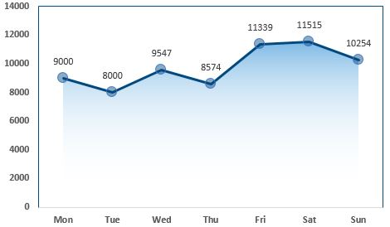
Line chart
Data Visualization
Types of Charts / Two Axis
A line chart is a graphical representation of an asset's historical price action that connects a series of data points with a continuous line. This is the most basic type of chart used in finance.
Advantages
Helps in detecting small changes that are difficult to measure in other graphs
Simple and easy to read and interpret
Aesthetically appealing
Notes:
Moving on to our next 2-axis chart which is line chart. Line charts are a very clever and visually appealing way to represent data. Line charts are very useful as they are made over a shorter range of time that helps to detect small changes which are generally difficult to find in other charts. They are quite easy to read and understand, as in this image you can see that the spikes tell you the trend of that asset along with its value.

Slide 14
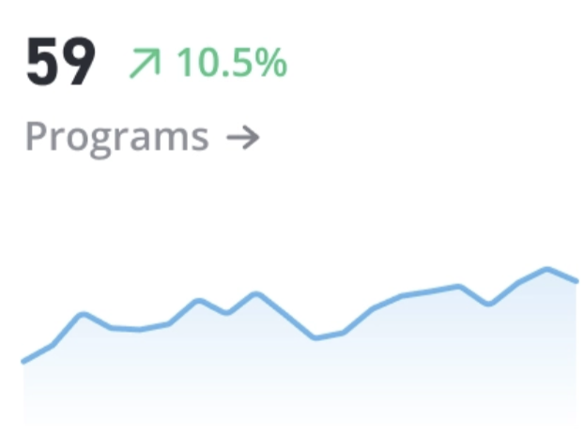
Line chart variations
Data Visualization
Types of Charts / Two Axis
Regular line chart
Spaghetti
Sparklines
Used to compare trends for multiple data sets
Displays multiple lines. Important to give filters to highlight a certain line
This is a smaller version of line chart which is used in finance apps to give a quick glimpse of data
Notes:
Talking about the variations in line chart, so line charts have 3 types of variations, the first one is a regular line chart which can be shown with or without datapoints. But remember as a designer, if you make a line chart for your product and if you are not showing data points, then they must be shown by hovering on the chart.
The second one is called a spaghetti, which is a more complex version of regular line chart. So, in spaghetti as you can see in the image, many lines are there with so many data points, therefore it becomes mandatory to give functionality to give extra focus to the line that a user wants to see. What it means is that, when on your dashboard you make a spaghetti, then make sure to give functionality like, dimming all other lines except the one on which user’s mouse pointer is.
The third variation is called a sparkline, which is generally used in finance. Sparklines are small glimpses of line charts that gives a quick look at the trends. They don't have data points and interactions.

Slide 15
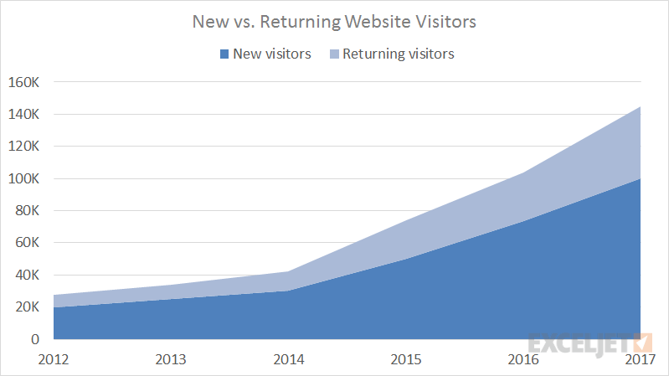
Area charts
Data Visualization
Types of Charts / Two Axis
Area charts are used to analyze the trend of a product or asset over time. It’s a time-series based graph that helps to understand the magnitude of a product.
Advantages
Perfect to explain trends for different assets of a company, which in turn, helps to predict outcomes and make informed business strategies
Easy to understand and read
Useful when you have large differences in your values
Notes:
Moving on to the lines of line chart. We come to area charts. An area chart is used to analyze trends of a product over time. This is helpful to predict outcomes and make correct business strategies. Well, you must have got a thought that area charts are looking similar to a line chart. Yes you are right, but wrong too. There is a major difference between the both. Area charts are used over a long range of time as they are focused only to give you trends and performances of a product. Whereas line charts are more precise and created over a short range of time to get accurate data points.

Slide 16
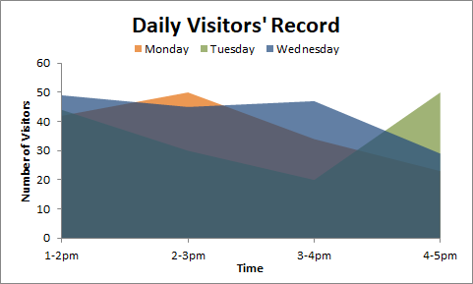
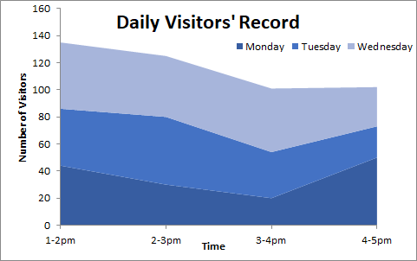
Area chart variations
Data Visualization
Types of Charts / Two Axis
Regular area chart
Stacked area chart
It shows all the datasets overlapping, often posing a readability issue
The areas of datasets are stacked with solid colors one behind the other, making it visible and easy to read
Notes:
Area charts also has 2 major variations, The first one is regular area chart which you can see in this image has all areas overlapping each other with a little transparent body.
The second one is a stacked area chart which is a stacked version of area chart. Remember here stacked is not the same as stacked bar chart. In area charts, stacked just means on top of each other, just to make the overall graph look clean because in the first image you see there is a mixture of colors, so to make it clear stacked area chart is useful.

Slide 17
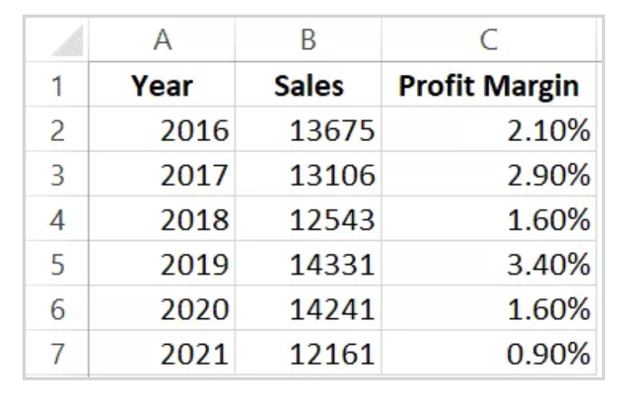
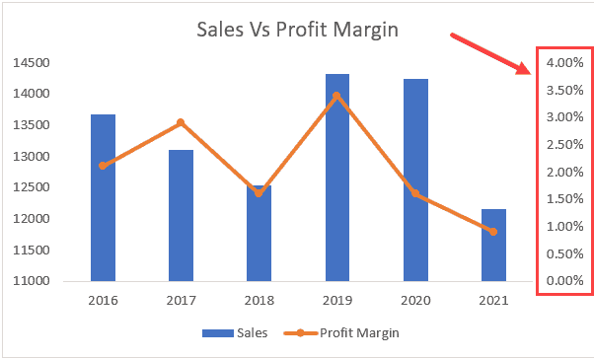
Dual axis chart
Data Visualization
Types of Charts / Two Axis
A dual axis chart uses two axes to easily illustrate the relationships between two variables with different magnitudes and scales of measurement. It’s a combination of bar chart and line chart.
Advantages
Used to compare two trends with each other
Easy to show data when the entities have huge numerical difference
Useful for two data series with completely distinct values, such as a country’s GDP on one axis and its life expectancy on the other
Helps to avoid switching between two graphs
Notes:
Dual axis chart is a very unique and useful graph. As you can see it is a combination of line charts and bar charts. A dual axis chart uses two axes to show the relationship between two variable with different magnitudes and scales. The relationship between two variables is referred to as correlation. This chart become unique because it saves a lot of space. Typically, to represent this dataset, you will need two different charts, but this chart combines them together.

Slide 18
TYPES OF CHARTS
No Axis Charts

Slide 19
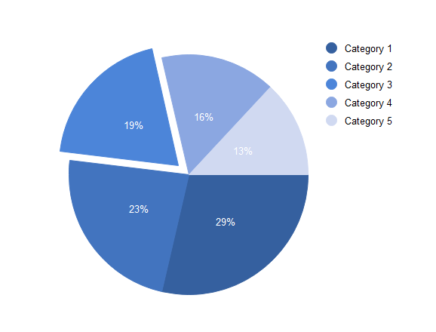
Pie chart
Data Visualization
Types of Charts / No Axis
A pie chart displays data in a circular graph. The pieces of the graph are proportional to the fraction of the whole in each category. The whole pie represents 100%.
Advantages
Easily gives your audience a general sense of the part-to-whole relationship
Helps to convey that one segment of the total is relatively small or large
Visually appealing and easy to read
Notes:
Pie charts are one of the most common charts that we use in our daily lives, that displays data in a circular layout. It follows the concept of part-to-relationship where the whole pie represents 100% or the maximum total value of a dataset. Pie charts are helpful to compare the parts and get a quick idea of how the data is performing.

Slide 20
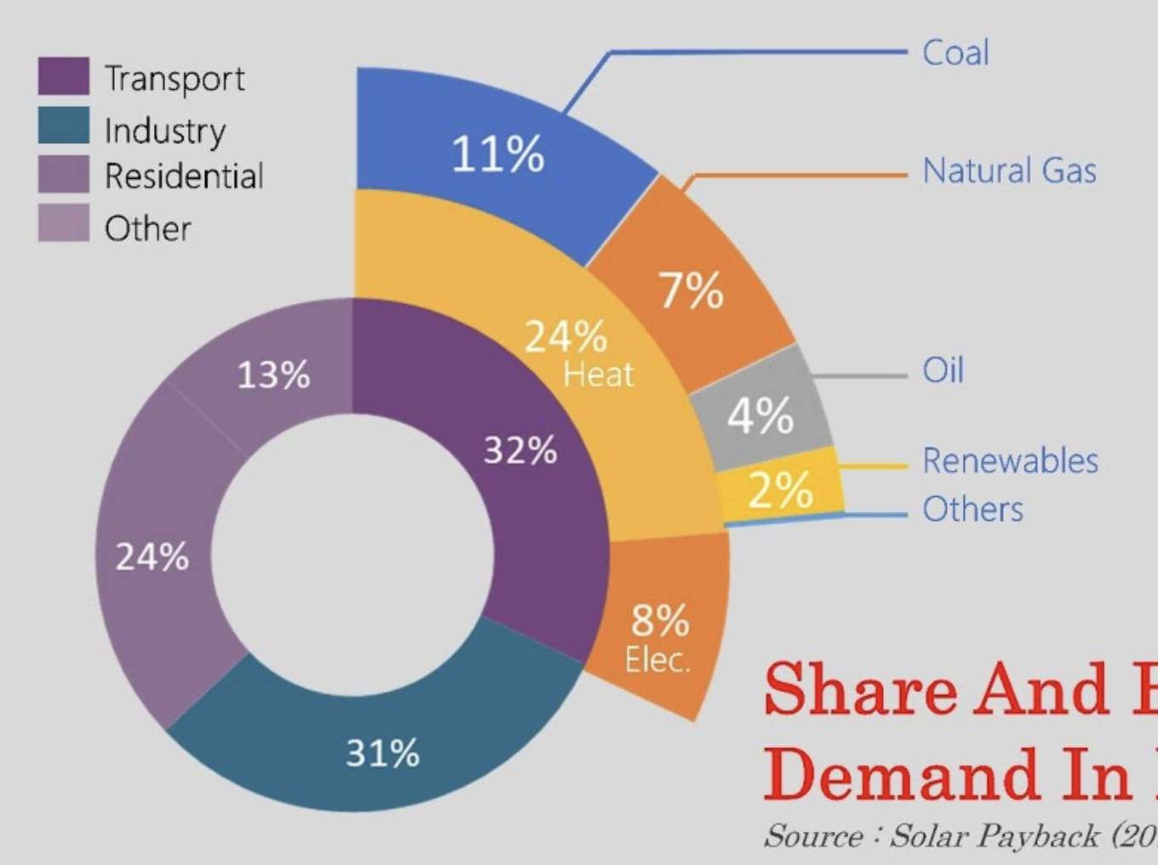
Pie chart variations
Data Visualization
Types of Charts / No Axis
Regular pie chart
Donuts
All data sets are plotted as parts of a whole pie that represents 100%
These are visually appealing and can also compare multiple data sets. These also help to compare data between multiple categories and datasets
Notes:
Pie charts have 2 main variations, The first variation is a regular version where only one data is represented in the pie and the whole pie is 100%. But this often had a problem when the data sets had more things to compare, and that is what gave rise to donut variation. The second variation is called donut variation, where more data can be compared. For example if you see on the third image, the purple part of 32% is divided into first 4 sub-data sets, and so on.

Slide 21
TYPES OF CHARTS
Color Intensity Charts

Slide 22
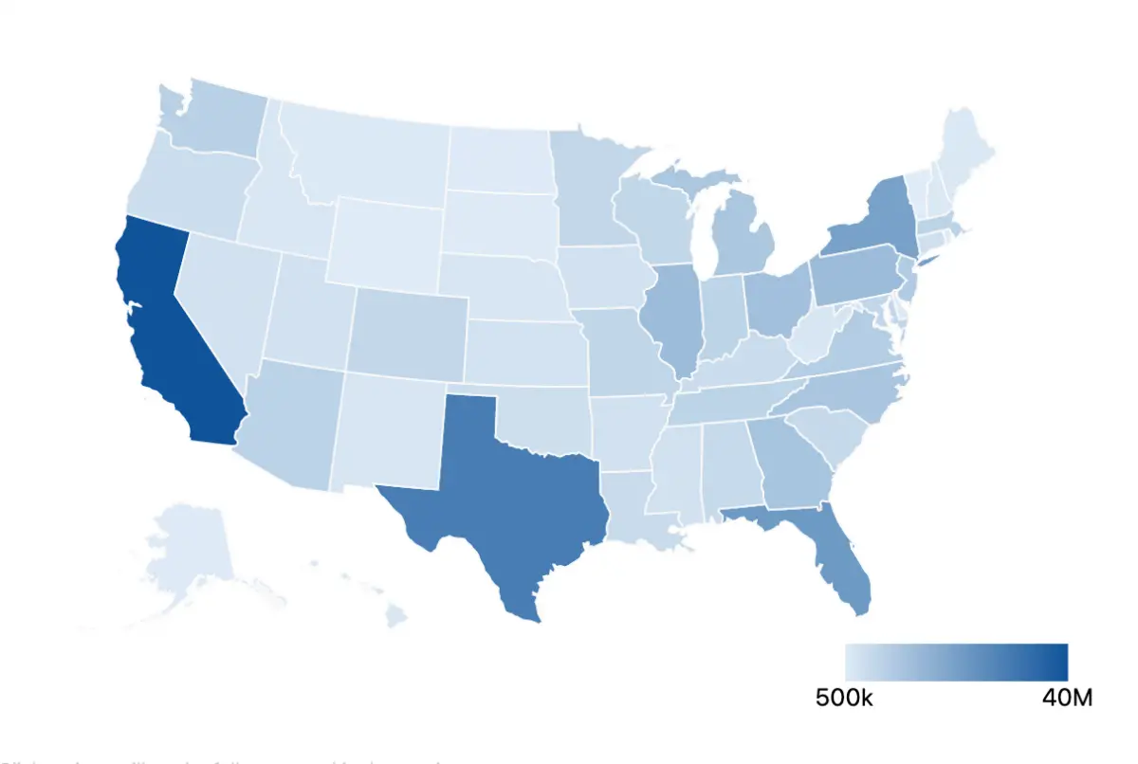
Heatmap
Data Visualization
Types of Charts / Color Intensity
Heat maps are graphical representations of data that utilize color-coded systems.
Advantages
They possess an uncanny ability to identify areas of interest quickly, and empower users to explore further and pinpoint where change must occur.
Assist in directing viewers towards areas on data visualizations that matter most.
Help to understand how customers are reacting to your website
Notes:
The most commonly used color intensity chart is a heatmap. Heatmaps are visually appealing and very easy to understand. The possess an uncanny ability to identify areas of interest quickly and empower users to explore further and pinpoint where change must occur. They assists in directing viewers towards areas on data visualization that matter the most. A quite common use case of heatmap would be that suppose, you have a website and you want to know which areas of your website are used or interacted the most. So, you create a heatmap of your website. It would be like an image of your website with certain areas highlighted in thermal colors.

Slide 23
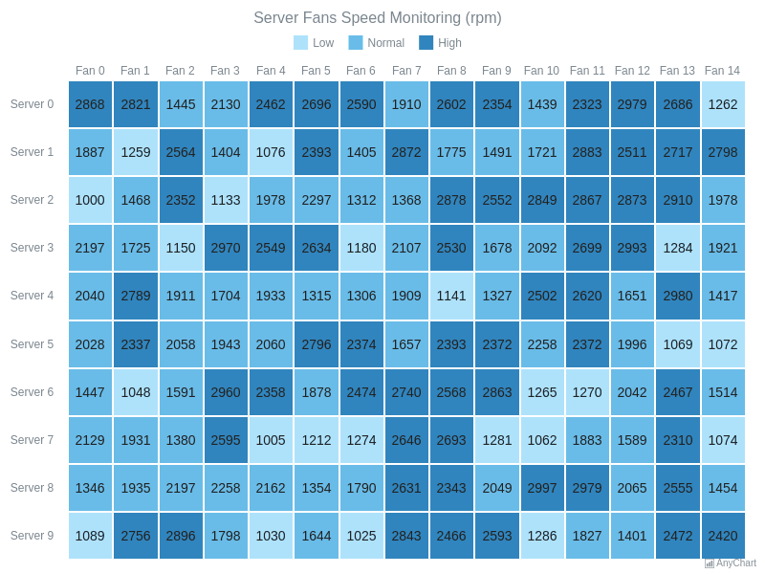
Heatmap variations
Data Visualization
Types of Charts / Color Intensity
Graphical View
Tabular Format
Generally used when datasets talk about regions, cities, countries, etc.
This version is used to compare data in a tabular format, but using intensities to create focus points
Notes:
Well, heatmaps are not only limited to a graphical or map view. It can also be shown in a tabular format. With each cell having a different color tone to create focus points. Anything in which you can use different color intensities can be called a heatmap. You may be having a question that why can’t we use a bar graph or pie chart if it’s just about colors. The answer is yes you can but only if your data set is small. A heat map is used when the dataset is huge so in order to save space and improve readability we use this instead of bar chart or pie chart

Slide 24
TYPES OF CHARTS
Financial Charts

Slide 25
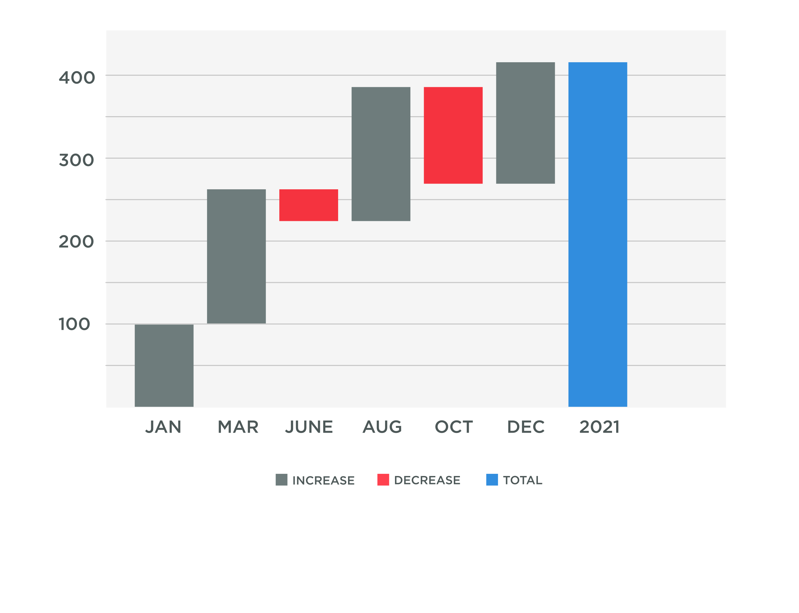
Waterfall chart
Data Visualization
A waterfall visualization shows how an initial value is increased and decreased by a series of intermediate values, leading to a final cumulative value shown in the far-right column.
Advantages
Helps in the Finance sector to exhibit how a net value is arrived at, by breaking down the aggregate effect of positive and negative contributions.
Easy to do financial calculations
Notes:
This is an additional type of chart that we wanted to discuss apart from other charts. So, a waterfall chart is mainly used for finance sector, and it is useful to understand how the initial value has increased or decreased by a series of intermediate values. In simple terms, if you look at this example, the far-right column is the total i.e. almost 400. For month of January the increase was from 0 – 100, then for March it was from 100 – 200 which means that there was a net profit of 100.

Slide 26
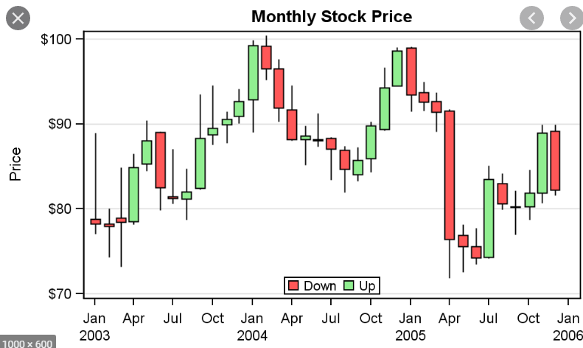
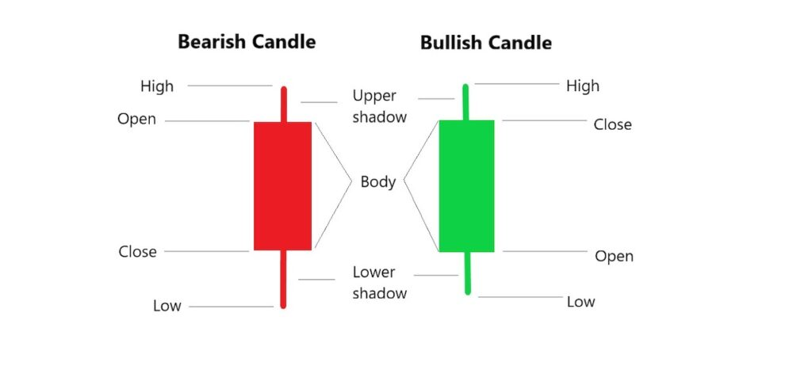
Waterfall chart variations
Data Visualization
Candlestick variant
Candlesticks show that emotion by visually representing the size of price moves with different colours.
Notes:
An indirect variant of waterfall chart is a candlestick chart which is used in financial apps only. Like cryptocurrency, stock trading, etc. The most important thing to consider for financial chart is that you should not redesign it unless required because there are API’s which provide a full scare candlestick chart. These charts are complex and therefore delicate too. Candlestick charts contain two main pieces i.e. a bearish candle (in red) and a bullish candle (in green)

Slide 27
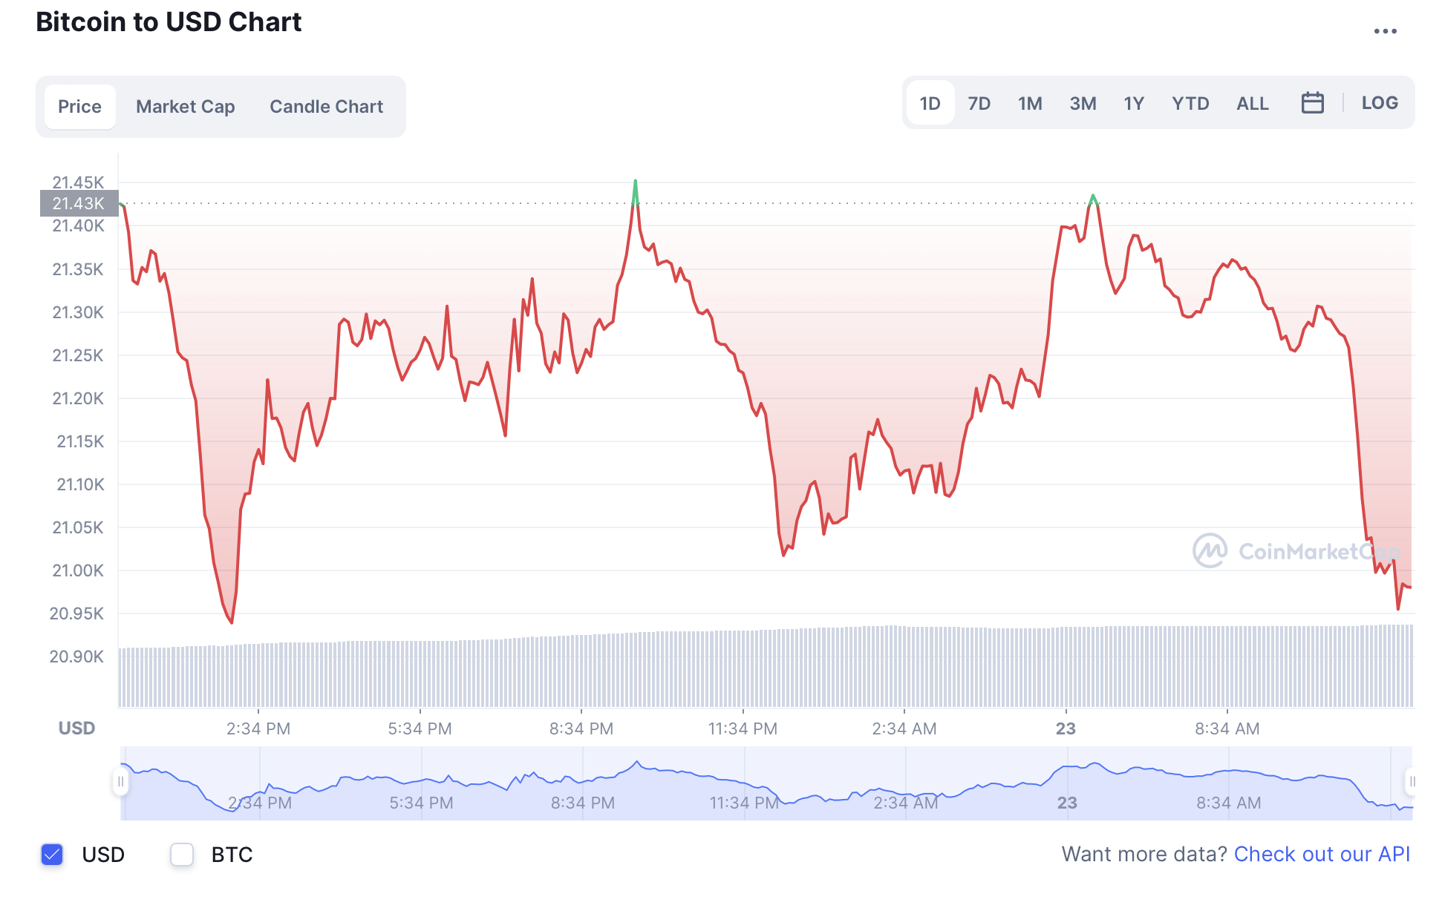
Data Visualization
Finest example of financial chart
Notes:
This is one of the best examples for a financial chart. Now this is not a candlestick variant, but it contains line graph, bar graph, area graph too. The reason why we kept this example is because, this being so complex chart has so many features, to filter data (the day-month-year) filter, easy transition to candle chart or line chart and so on.

Slide 28
TYPES OF CHARTS
Quiz Time

Slide 29

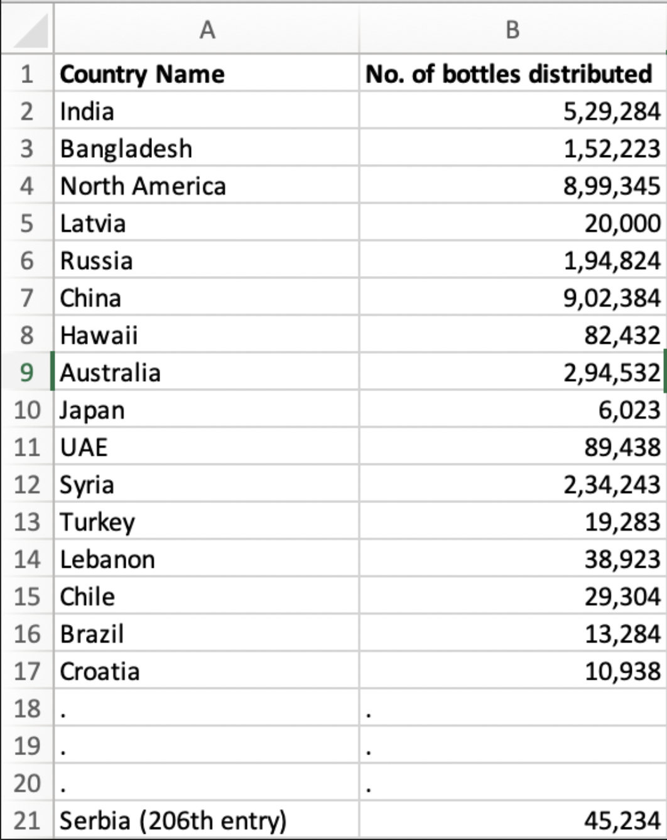
A short quiz
Data Visualization
1
1
Situation 1
Where is the report ?
You are a UX researcher and recently asked to analyse the Covid 19 vaccine distribution reports for all the countries in the world. Your boss is furious because the report has 206 entries in tabular format and it is very difficult to come to any conclusion with this kind of dataset.
Which of the following graphs will you prefer ?
Stacked bar chart
Area chart
Heatmap
Pie chart
Notes:
Voilà ! Congratulations on completing types of charts, but its not over yet, its quiz time to test what you have learnt. In this section you will have two questions, and 4 options. All the options are correct and there is not wrong answer, but only one option is the most appropriate one. You will need to recall all knowledge from types of charts to get the correct answer. So, here’s the first situation You are a UX researcher, and has recently been given a task to analyse the covid 19 vaccine distribution reports for all the countries in the world. Your boss is furious because the report has 206 entries in tabular format and its very difficult to come to any conclusion. With this kind of dataset.
ANSWER The most appropriate answer here is to use a heatmap. Can anyone tell me, why can’t we use a pie chart here ? Because world has more than 206 countries, which means, representing 206 small parts in a pie chart will be very heavy and messy. Only a few things will be readable.

Slide 30
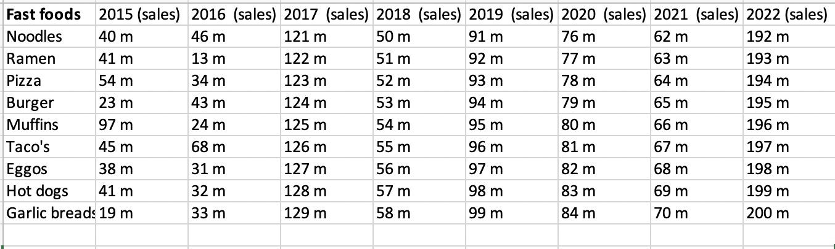
Data Visualization
2
Situation 2
What went wrong ?
For your expertise as a UX researcher, you clinched a job with Dominos. You noticed your manager taking down notes. You knew he was under heavy work load already and enquired.
She was trying to analyze raw data to identify current tends in fast food items, in a bid to introduce new items in the menu. You, being a good employee, decided to help her.
Which of the following graphs will you prefer to represent this data ?
Stacked bar chart
Area chart
Line chart
Pie chart
M = Millions
Notes:
Here’s one more question to test your knowledge so far….. For your excellent job as a UX researcher, you got an offer from Dominos to work for them. One day you saw your manager under heavy work load making notes. Upon asking you got to know she is trying to analyse raw data to look how fast food trends have been moving to bring new items in their menu. You being a good employee decided to help her.
ANSWER
Line chart. As you can see, that you manager needs to look for trends, which means you need a line chart to get an idea.
Now most of you might be thinking that why not an area chart, because, if you use area chart for 10 fast foods, its going to become a mess. Line chart also serves as an area chart but only when the data is more for an area chart to handle.

Slide 31
DATA VISUALISATION
Handy tips

Slide 32

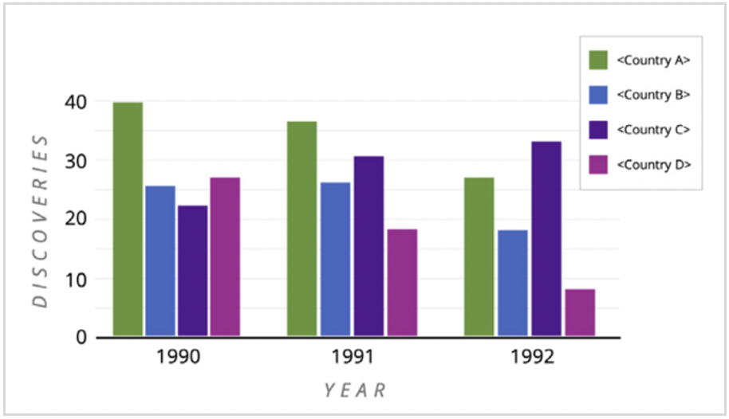
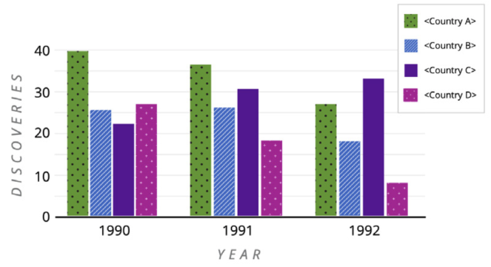

Make your charts accessible
Data Visualization
Use dashed/dotted line styles, and/or varying line widths, for bar charts and other similar data visualizations.
Notes:
By using textures instead of color, it’s possible to make graphs easy to understand to color blind people, and by applying patterned overlays to solid colors you give users a clearer way to distinguish between different elements. This not only helps those who are colorblind, but also makes it easier to distinguish different elements for everyone who will see this information.
To make the charts accessible to the color blind users use different pattern fills for bar charts and other similar data visualizations. This helps color-blind users and Make sure the color of each pattern has a 3:1 (or greater) contrast ratio with the background color of its bar.
Use dashed/dotted line styles, and/or varying line widths, for line graphs and other similar data visualizations. Different line widths work when there is a limited number of lines in the chart allowing for the line widths to be obviously different from one another. Don’t forget to apply the same line styles in the legend.
In this article, I will share with you the best chart accessibility practices, and how you can practically create an effective accessibility friendly charts.

Slide 33
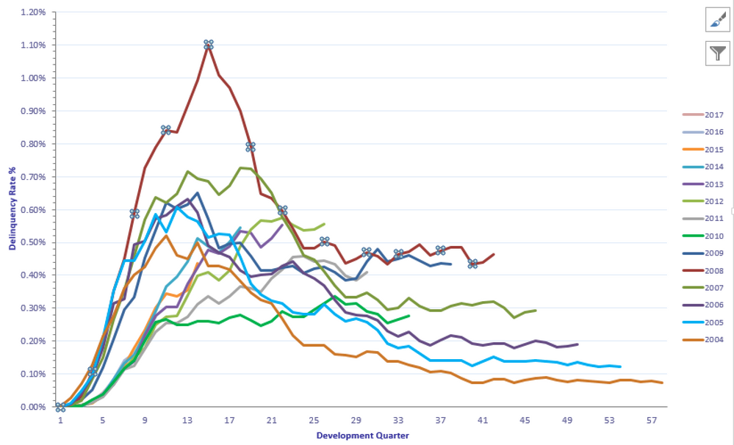
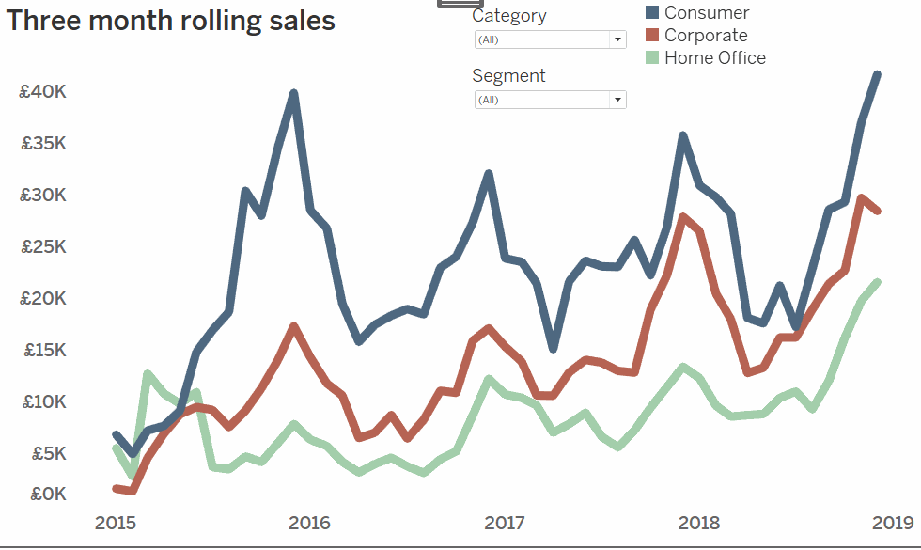
Make your charts interactive
Data Visualization
Use dashed/dotted line styles, and/or varying line widths, for bar charts and other similar data visualizations.
Notes:
It is very important that when you design charts for a product, they should be interactive and should give ease a user's life. Charts respond to different screen sizes differently, therefore it becomes important to give features like “Showing only a specific type of data”, “ zoom in, zoom out”, ”sharing graph”, and many more such features.

Slide 34
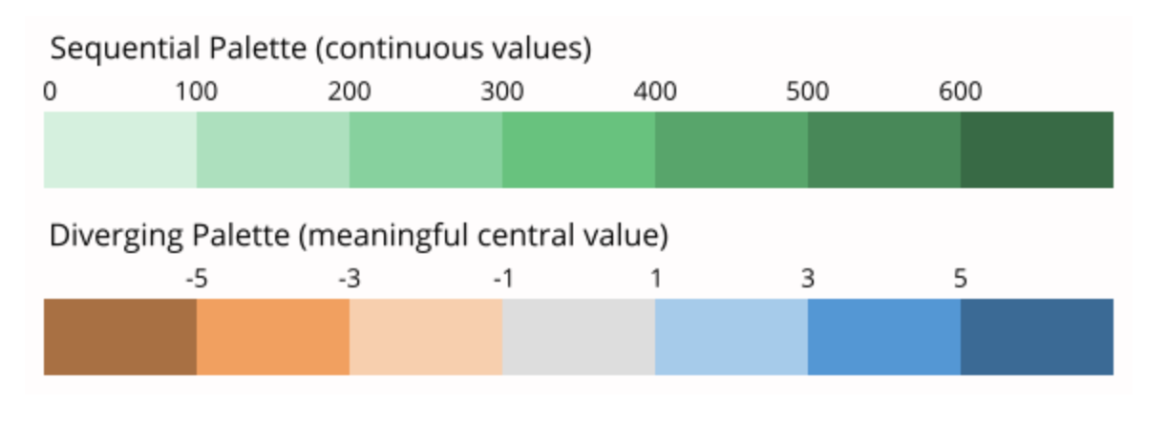
Engage with colors
Data Visualization
Use lighter colors to indicate lower values and darker colors to indicate higher values. Diverging color palette may be used when there is a meaningful central value.
Notes:
Colors play an important role in depicting graphs without using words. It captures the users' attention and helps to communicate a lot about your visuals. In order to create effective charts, a good combination of colors is important, and it will help to understand the story of the visualization and engage with the users. Whereas a poor color combination will hide or distract from the values of visualization.
So as part of best practices, there are three different kinds of color schemes for maps that we can use:
Sequential (e.g. from bright blue to dark blue.
Divergent (e.g. from red via white to blue.
Categorical (e.g. one green color, one blue color
Sequential and divergent color palettes should be used to render changes in magnitude by encoding qualitative values while categorical color palettes should be used to render unrelated data categories by encoding quantitative values.
Consider using the same color for the same variables. If you just use one color for all your charts, using the same color is the best option to make your article not overly colorful. For example, it’s ok to show the unemployment rate in blue in the first chart and a few paragraphs later a GDP chart with the same color. However, if you use more than one color for your first chart, the colors in this chart will be “taken”. To not confuse readers and increase comparability, consider only using these colors again if you’re showing data about the same category/country/etc.
Sequential colors have numeric meaning. These are a gradation of colors that go from light to dark. (Consider a sequential color scheme if you want to drive the attention to the high values, e.g. for unemployment rates)
Diverging colors also have numeric meaning. They’re useful when dealing with negative values or ranges that have two extremes with a baseline in the middle.
(Consider a diverging scheme if you want to drive the attention to both extremes of the scale, e.g. too show the difference in votes between two competing parties.)
Categorical colors scheme help users map non-numeric meaning to objects in a visualization. These are designed to be visually distinct from one another. The Spectrum categorical 6-color palette has been optimized to be distinguishable for users with color vision deficiencies.(Consider a
https://towardsdatascience.com/8-rules-for-optimal-use-of-color-in-data-visualization-b283ae1fc1e2

Slide 35
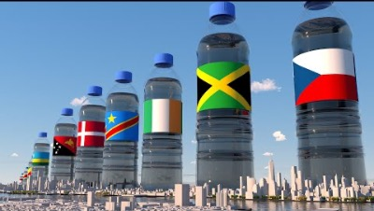
Other styles of data visualization
Notes:
They have combined the data with the location it belongs to. Like, for the use of water, they used the image of water bottles, and for the ocean's depth, they created a view of its depths. It connects users to your data and helps them to understand the information quickly.

Slide 36
DATA VISUALISATION
Popular Tools
& Libraries

Slide 37





Tools
Data Visualization
Data visualization tools, incorporating support for streaming data, AI integration, embeddability, collaboration, interactive exploration, and self-service capabilities facilitate the visual representation of data.
37
Notes:
There are some top-notch data visualization tools that are gaining market recognition for their impressive performance and usability. And all the tools have their own advantages and disadvantages which we can talk about in upcoming sessions.

Slide 38
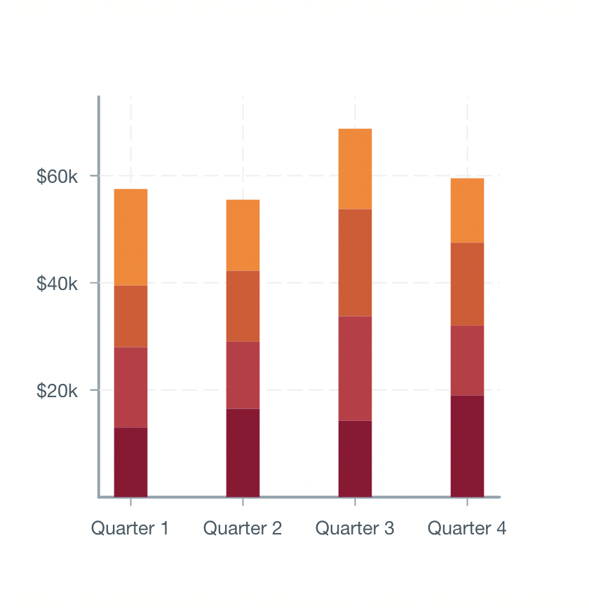
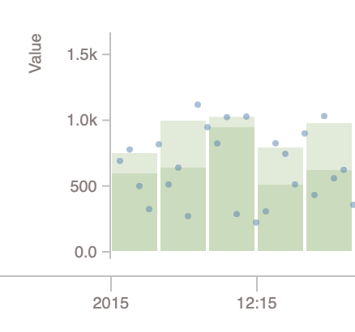
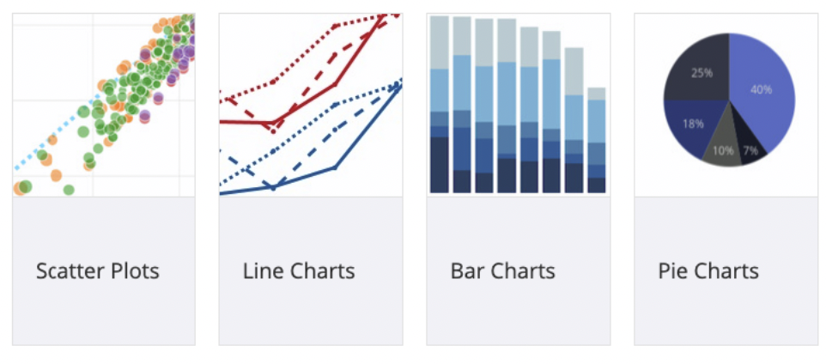
React.js & Angular.js graph libraries
Data Visualization
Recharts
Ngx-charts
Most reliable library
Commonly used
Has native SVG support
Easy to use
Has visually appealing charts
Needs less customization
Victory
React-time series
Uses same API for all applications
Suitable for generating iOS & Android graphs
Suitable for time-series data
Notes:
React.js & Angular.js graph libraries
Before wrapping up this course, it is also important to understand the developer’s point of view on charts. When you design a product, it is highly probable that your developer is going to use some javascript library to create graphs, which can be customized too. Some of the libraries are : 1. Reacharts which is quite commonly used library 2. Victory which is good for iOS and android charts 3. React-time series which is suitable for time-series based graphs 4. Ngx-charts which is a more modern library in terms of chart options they provide

